Slide 1


Introduction to Bootstrap
Topics
What and Why Bootstrap?
Advantages of Bootstrap
Getting started with Bootstrap
Bootstrap grid basics
Helper classes and responsive Utilities
Working with buttons
Q&A
Session Coming on:
Topic : Introduction to Bootstrap
Date : 24th Oct, 2018
Timing : 2:30 PM to 3:30 PM IST
Presenter : Camy Dsilva
Account : GE Corporate
Visit Us @: Capgemini GE GDC Intranet
Feedback @: GEInnovation@capgemini.com
Notes:
Fixar a posicao do titulo – sempre do lado esquerdo.
Sempre que tiver muito texto o coluna deve sempre ser “ narrowed” , se nao fica dificil de ler. Colocar paragrafos no texto.
Linha vertical deve ser mais fina e as pontas NUNCA devem ser arredondadas.

Slide 2
What and Why Bootstrap
What is Bootstrap :
Bootstrap is an open source, responsive design framework to build static websites and dynamic web applications..
Bootstrap was developed by Mark Otto and Jacob Thornton at Twitter. It was released as an open source product in August 2011 on GitHub.
Bootstrap is completely free to download and use.
Why Bootstrap :
Bootstrap's supports responsive design.
Bootstrap contains a dozen of built-in reusable components.

Slide 3
Bootstrap Advatages
Responsive feature
Cross-border support
Easy to use
Mobile first approach
Easy to customize `

Slide 4
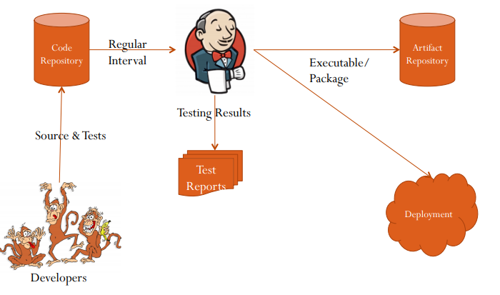
Where we can fit the Jenkins in CI
Key Roles of CI with Jenkins :
Developers
Repository
Jenkins
Reports
Artifacts
Deployments

Slide 5
Setup and Configuration
Prerequisites:
Minimum hardware requirements
256 MB of RAM
1 GB of drive space
Recommended hardware configuration for a small team:
1 GB+ of RAM
50 GB+ of drive space
Software requirements:
Java: Java 8 ,runtime environment, both 32-bit and 64-bit versions are supported
Web browser: Web Browser Compatibility with system.
Google Chrome,Morzilla etc.
The (WAR) file version of Jenkins can be installed on any operating system or platform that supports Java.
Download the latest stable Jenkins WAR file
Open up a terminal/command prompt & Run the command java -jar jenkins.war.
Browse to http://localhost:8080 and wait until the Unlock Jenkins page appears.

Slide 6
Jenkins Tool Walkthrough
Demo

Slide 7
Jenkins Plugin
Demo

Slide 8
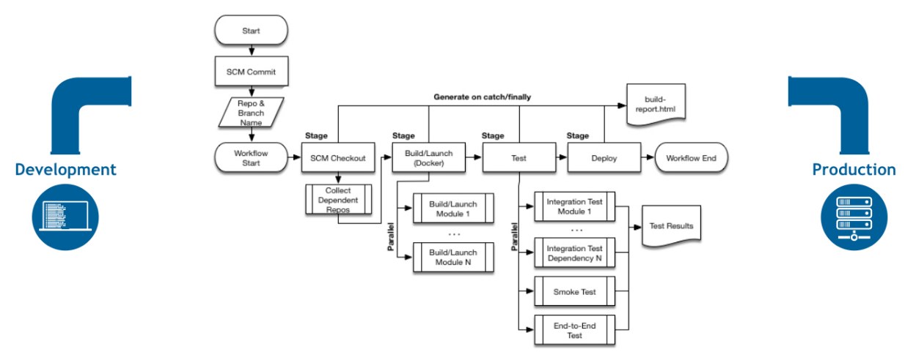
Jenkins Pipeline and Jenkinfile
What is a Jenkins pipeline?
A pipeline is a collection of jobs that brings the software from version control into the hands of the end users by using automation tools. It is a feature used to incorporate continuous delivery in our software development workflow.

Slide 9
Jenkins Pipeline and Jenkinfile (Contd)
Pipeline Concepts:
Pipeline:
user-defined model
defines your entire build process,
includes stages for building, testing and delivering.
Node
A node is a machine which is part of the Jenkins environment and is capable of executing a Pipeline.
Stage
distinct subset of tasks performed through the entire Pipeline
Like "Build", "Test" and "Deploy" stages
Step
step that tells Jenkins what to do at a particular point in time

Slide 10
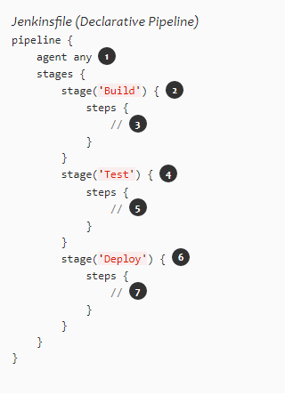
Jenkins Pipeline and Jenkinfile (Contd)
Pipeline syntax overview
Declarative Pipeline syntax and Scripted Pipeline syntax
Declarative Pipeline fundamentals
The Pipeline block defines all the work done throughout Pipeline.
Execute this Pipeline or any of its stages, on any available agent.
Defines the "Build" stage.
Perform some steps related to the "Build" stage.
Defines the "Test" stage.
Perform some steps related to the "Test" stage.
Defines the "Deploy" stage.
Perform some steps related to the "Deploy" stage.

Slide 11
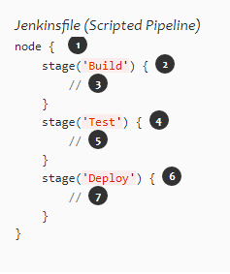
Jenkins Pipeline and Jenkinfile (Contd)
Scripted Pipeline fundamentals
One or more node blocks do/es the core work throughout the entire Pipeline.
Schedules the steps contained within the block to run by adding an item to the Jenkins queue. As soon as an executor is free on a node, the steps will run.
Creates a workspace (a directory specific to that particular Pipeline) where work can be done on files checked out from source control.
Execute this Pipeline or any of its stages, on any available agent.
Defines the "Build" stage. stage blocks are optional in Scripted Pipeline syntax. However, implementing stage blocks in a Scripted Pipeline provides clearer visualization of each `stage’s subset of tasks/steps in the Jenkins UI.
Perform some steps related to the "Build" stage.
Defines the "Test" stage.
Perform some steps related to the "Test" stage.
Defines the "Deploy" stage.
Perform some steps related to the "Deploy" stage.

Slide 12
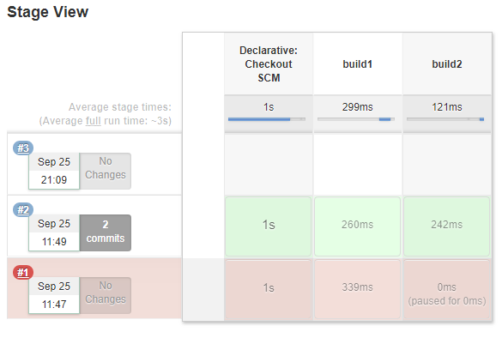
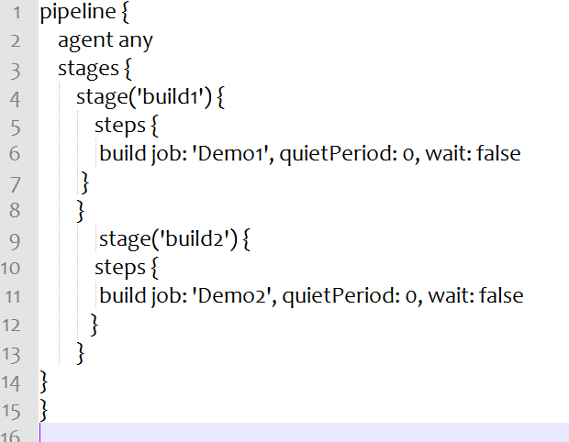
Jenkins Pipeline and Jenkinfile (Contd)

Slide 13
Any Questions?

Slide 14
Thank You!!

